Slide 1
♻️ Waste Classification using Deep Learning
Garbage Image Classification Project
Deep Learning + Streamlit Deployment
Avanthi

Slide 2
Problem Statement
Build a deep learning model to classify waste images.
Categories: Plastic, Metal, Glass, Paper, Cardboard, Trash.
Automate recycling through image-based sorting.

Slide 3
Business Use Cases
Smart Recycling Bins – Automatic waste sorting.
Municipal Waste Management – Reduce manual labor.
Educational Tools – Teach waste segregation.
Environmental Analytics – Track recycling trends.

Slide 4
Dataset Overview
Dataset: Garbage Classification (6 Classes).
Total Images: 2,467.
Classes: Cardboard, Glass, Metal, Paper, Plastic, Trash.

Slide 5
Data Preprocessing
Resized images to 224x224.
Normalized pixel values.
Applied data augmentation (rotation, flipping, zoom).
Handled class imbalance.

Slide 6
Exploratory Data Analysis (EDA)
Visualized class distribution.
Displayed sample images.
Analyzed pixel intensity patterns.

Slide 7
Model Development
Used Transfer Learning.
Models: ResNet50, MobileNetV2, EfficientNetB0
Frozen base layers.
Added custom dense layers for classification.

Slide 8
Model Evaluation
Metrics: Accuracy, Precision, Recall, F1-Score.
Generated Confusion Matrix.
Selected best model based on F1-score.

Slide 9
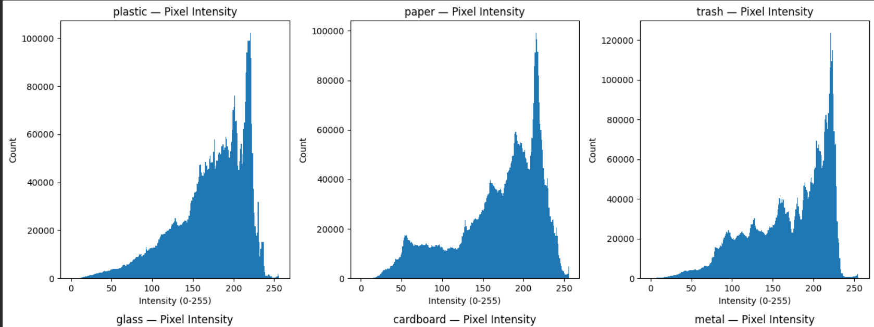
EDA

Slide 10
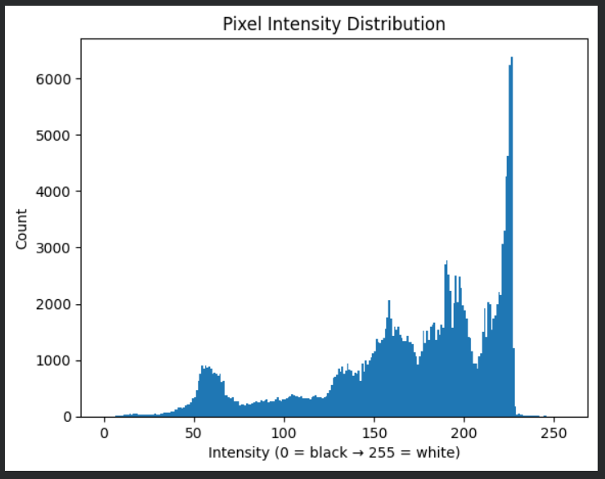
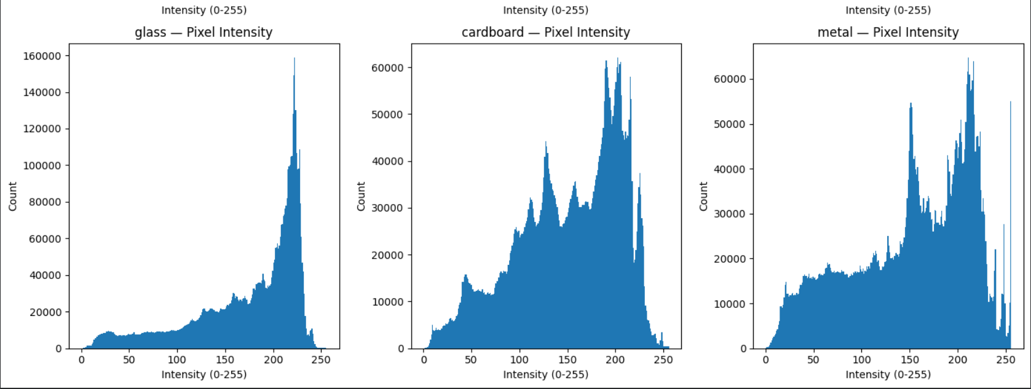

Slide 11
Streamlit Application
Upload waste image.
Predict waste category.
Display confidence score.
Optional: Show Top-3 predictions.

Slide 12
Results & Impact
High classification accuracy achieved- 0.86.
Efficient waste segregation system.
Supports sustainable environmental practices.

Slide 13
Future Improvements
Add real-time camera detection.
Expand dataset size.
Implement model explainability (Grad-CAM).
Deploy mobile-friendly version.

